Slide 1
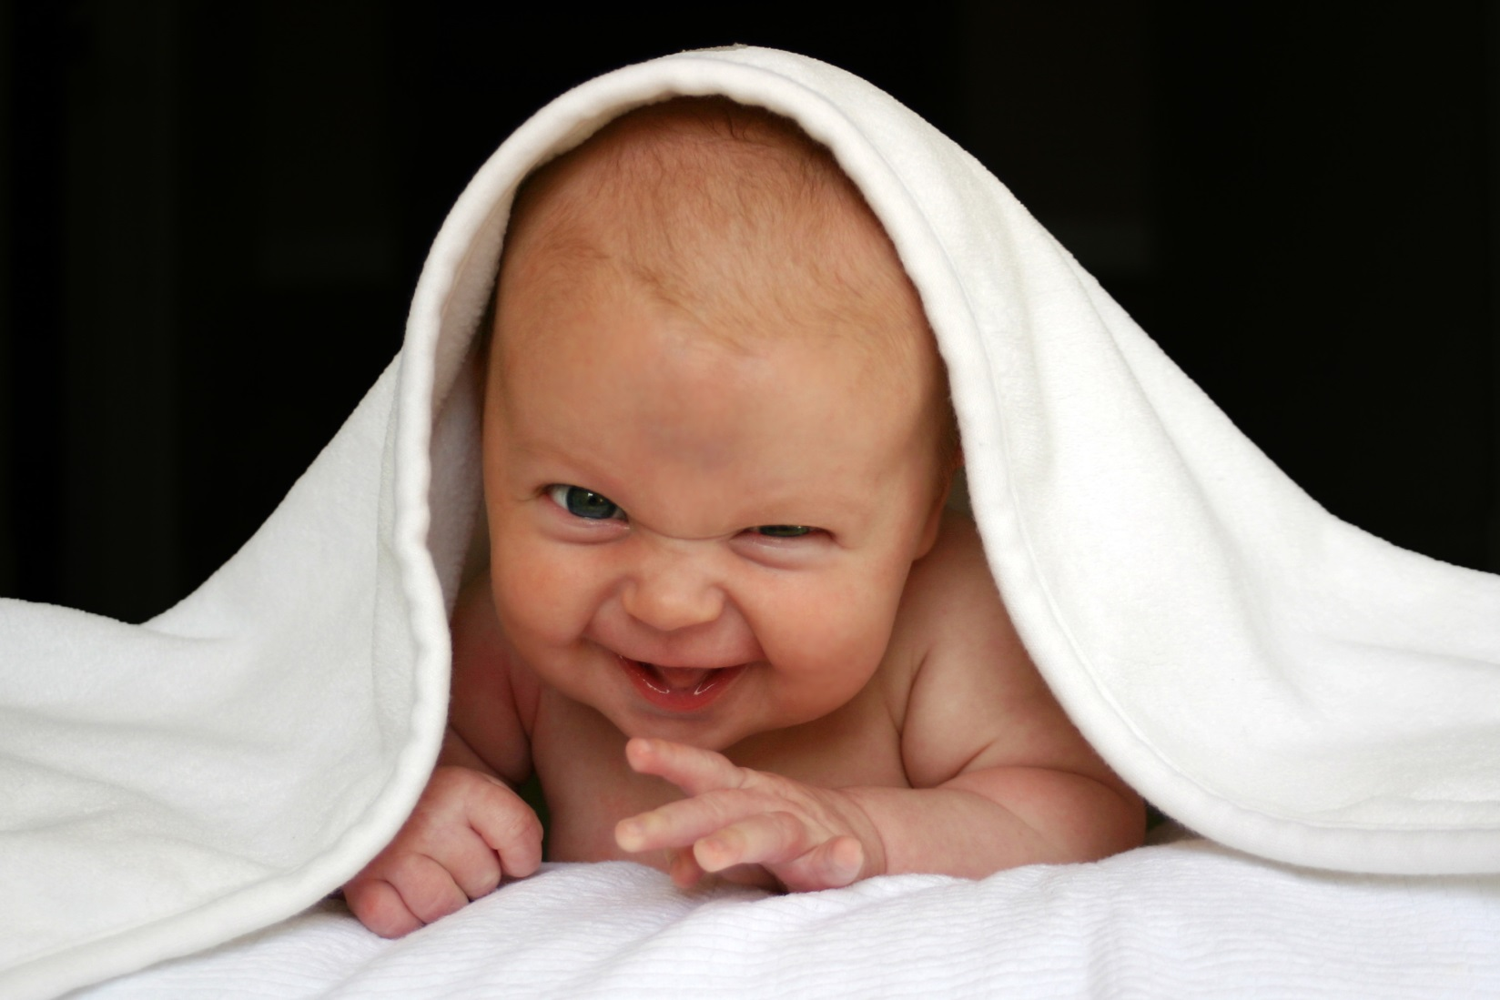
When I Feel Happy
The GRIT Program, 2016
Notes:
Scripted stories can also be used to help demonstrate anger. This is a sample of a story you might use.

Slide 2
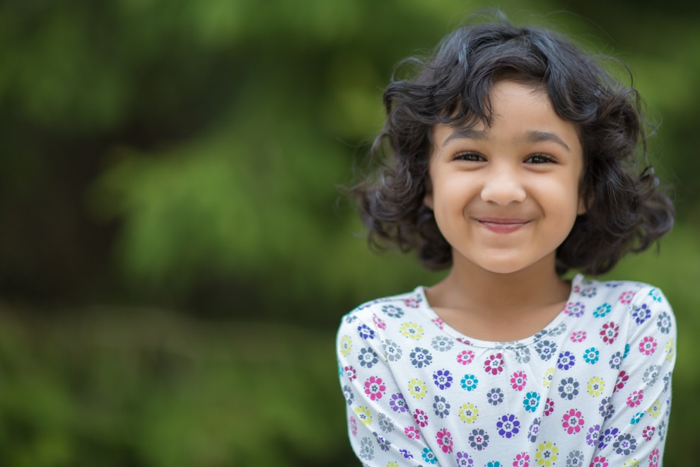
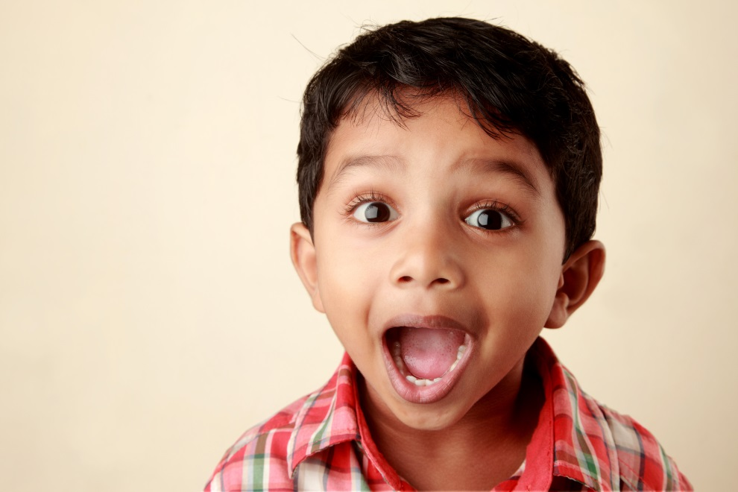
Sometimes, I feel happy.
Sometimes I feel really happy.
This is called excited.
1

Slide 3
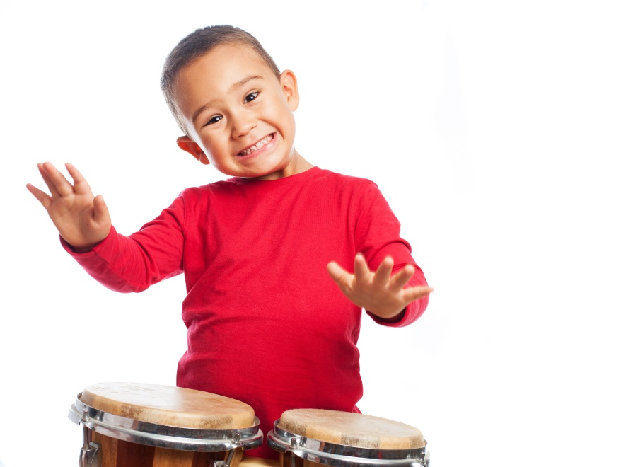
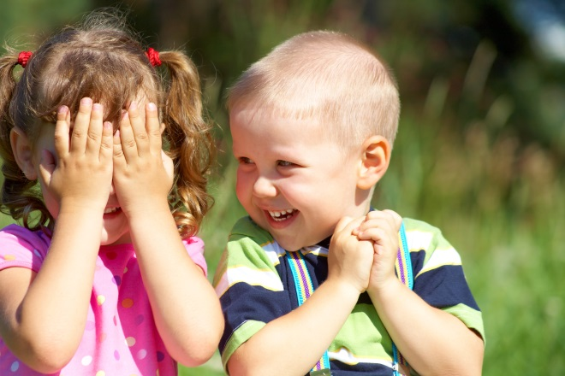
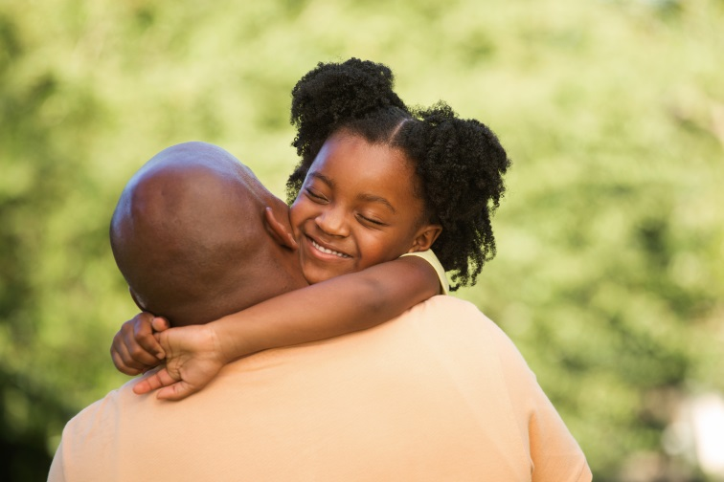
I might feel happy when…
I am playing with my best friend.
I get a new toy or book.
My parents give me a hug.
2

Slide 4
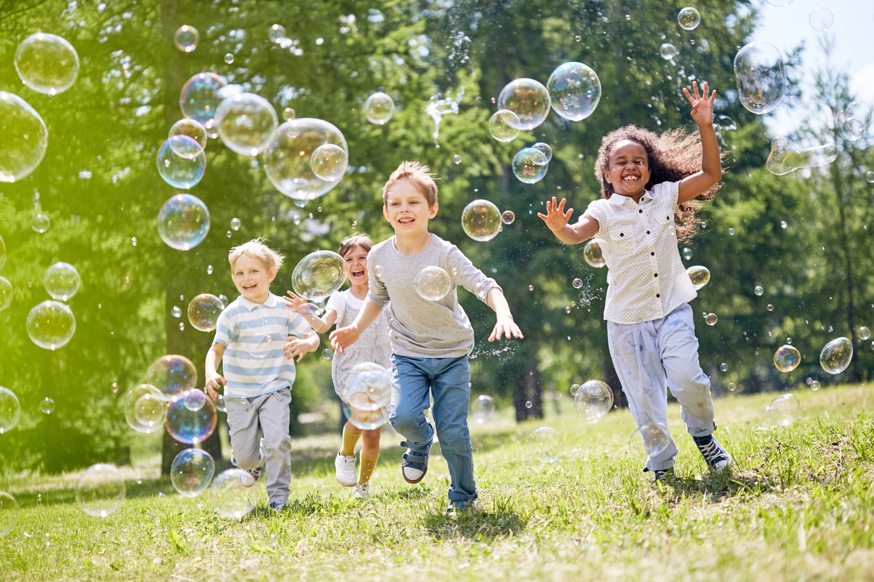
When I feel happy, I might feel bubbly inside.
I smile, and maybe giggle.
3

Slide 5
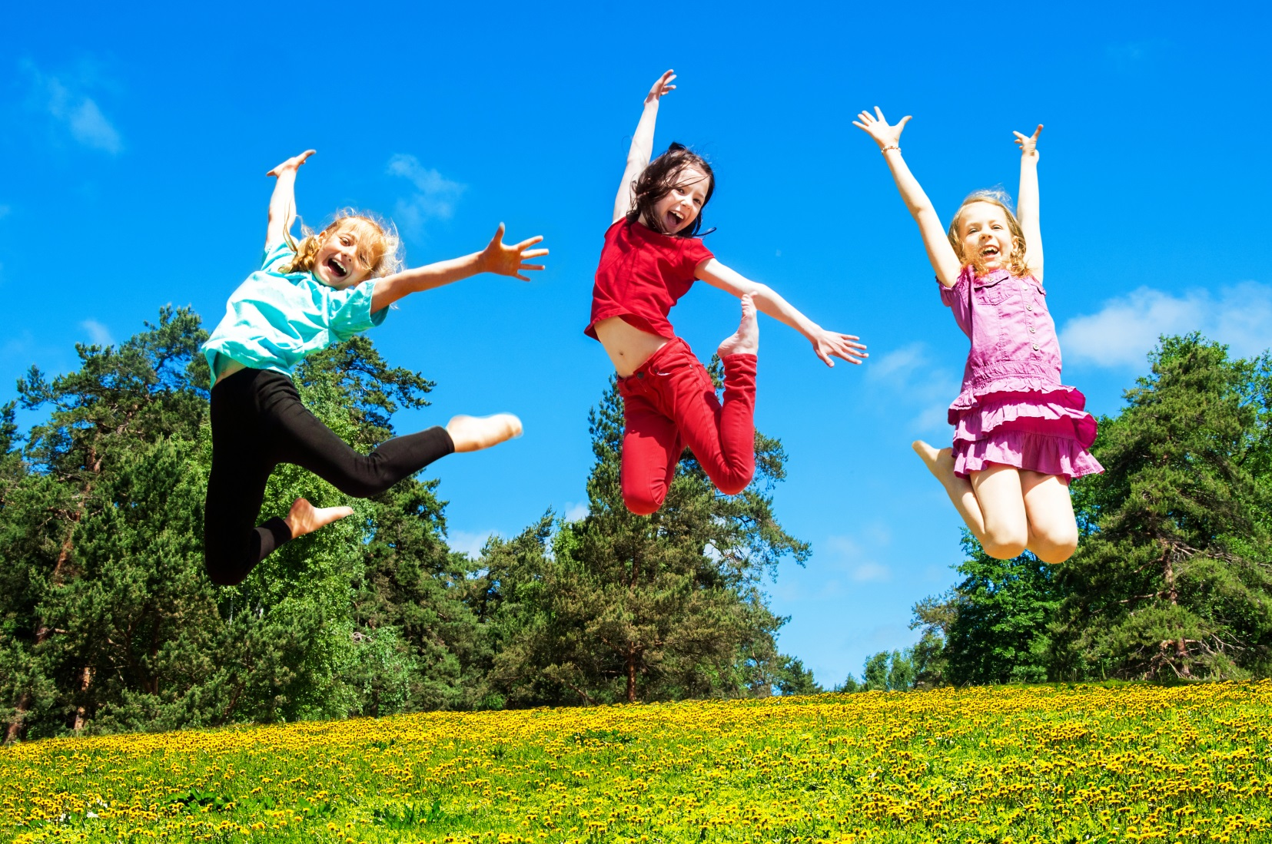
I might feel like jumping up and down.
4

Slide 6
When I feel happy, I can share my happiness with others.
5
Notes:
Do you think this book should include some examples of HOW to feel better? Or appropriate ways to express anger?

Slide 7
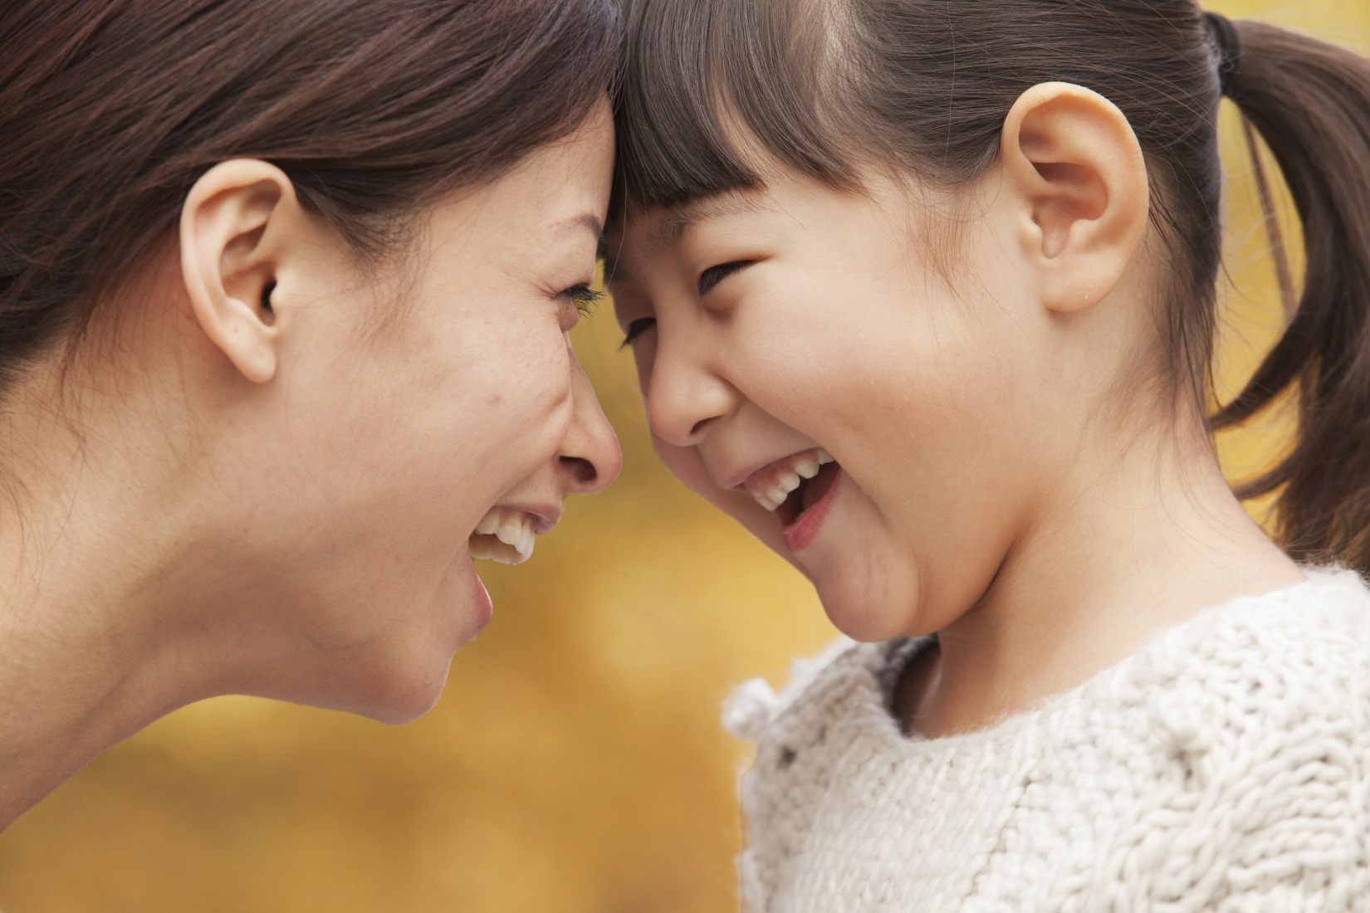
When I am feeling happy, I can use my words to tell people: “I’m so happy!”
6
Notes:
This scripted story is a continuation of the story we read earlier – it is moving from recognizing anger to expressing it appropriately.

Slide 8
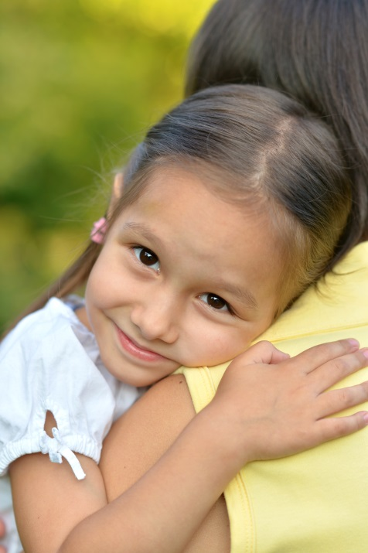
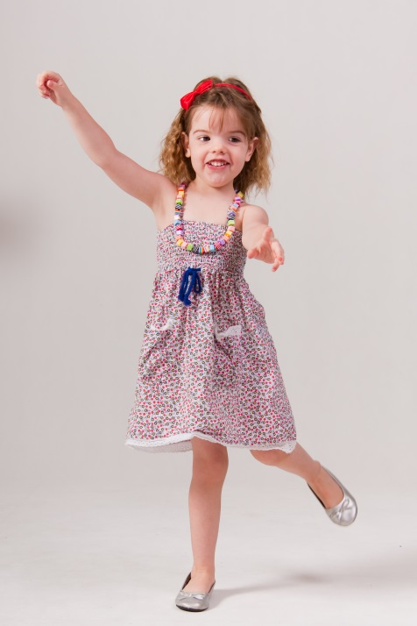
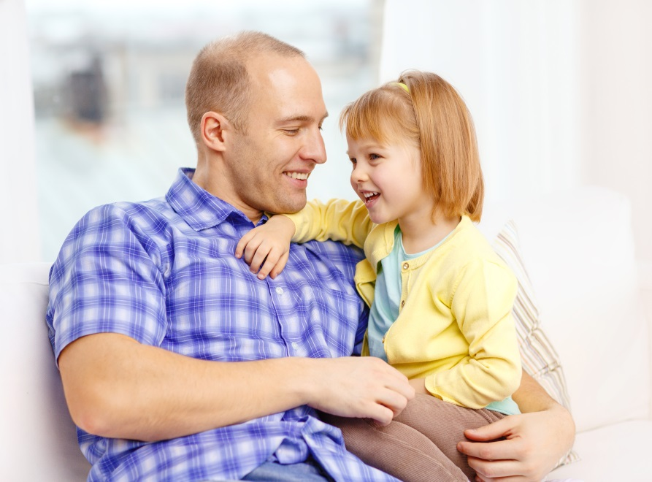
I can do other things when I am happy.
I can sing and dance to music.
I can
hug someone.
I can tell someone great news.
7

Slide 9
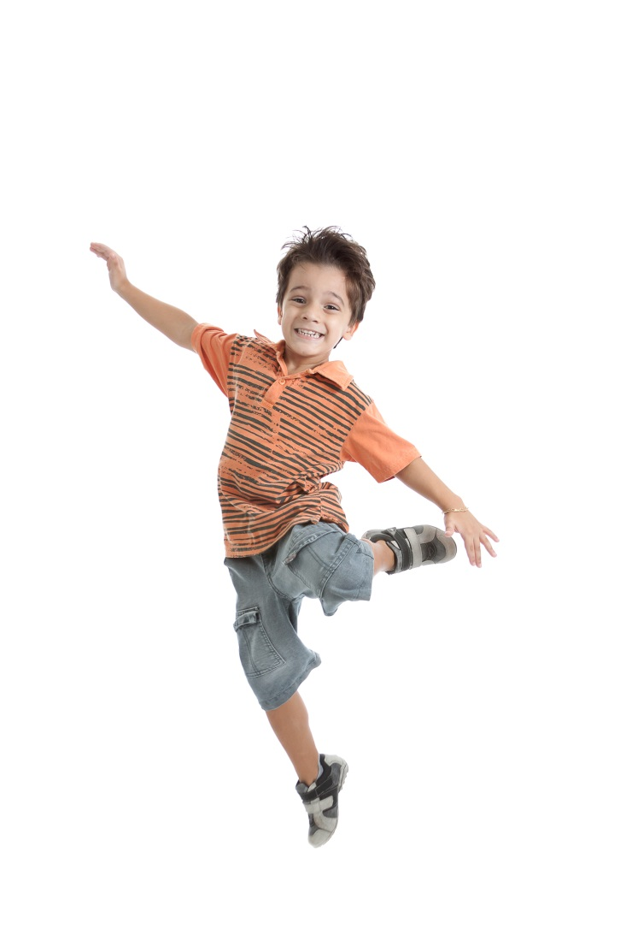
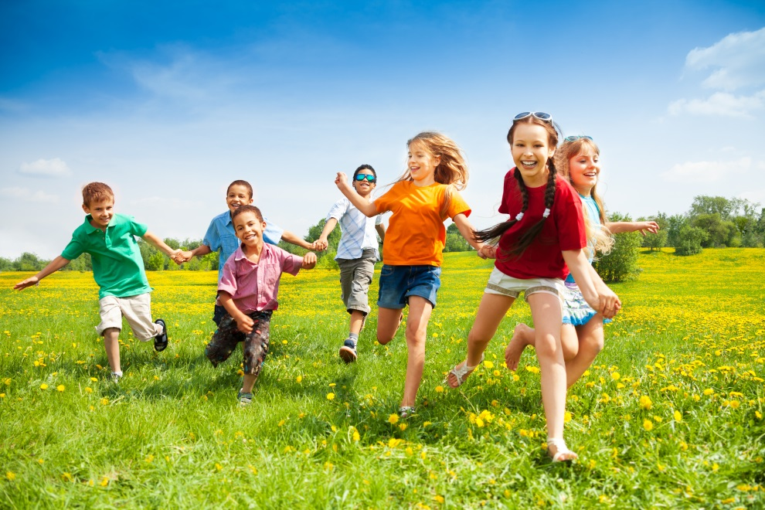
When I’m outside, I can even:
Run down the hill
I can jump and cheer.
8

Slide 10
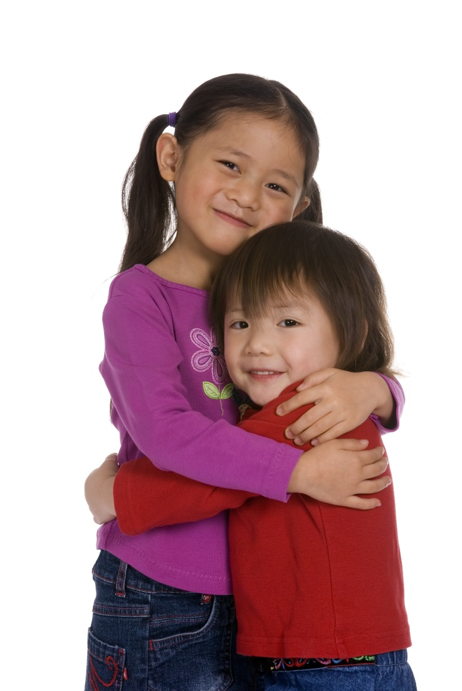
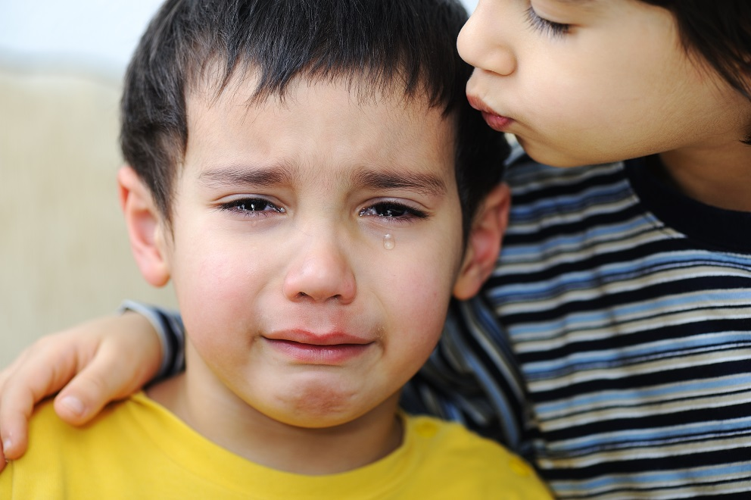
If I notice someone who is a bit sad, maybe I can help cheer them up!
9

Slide 11
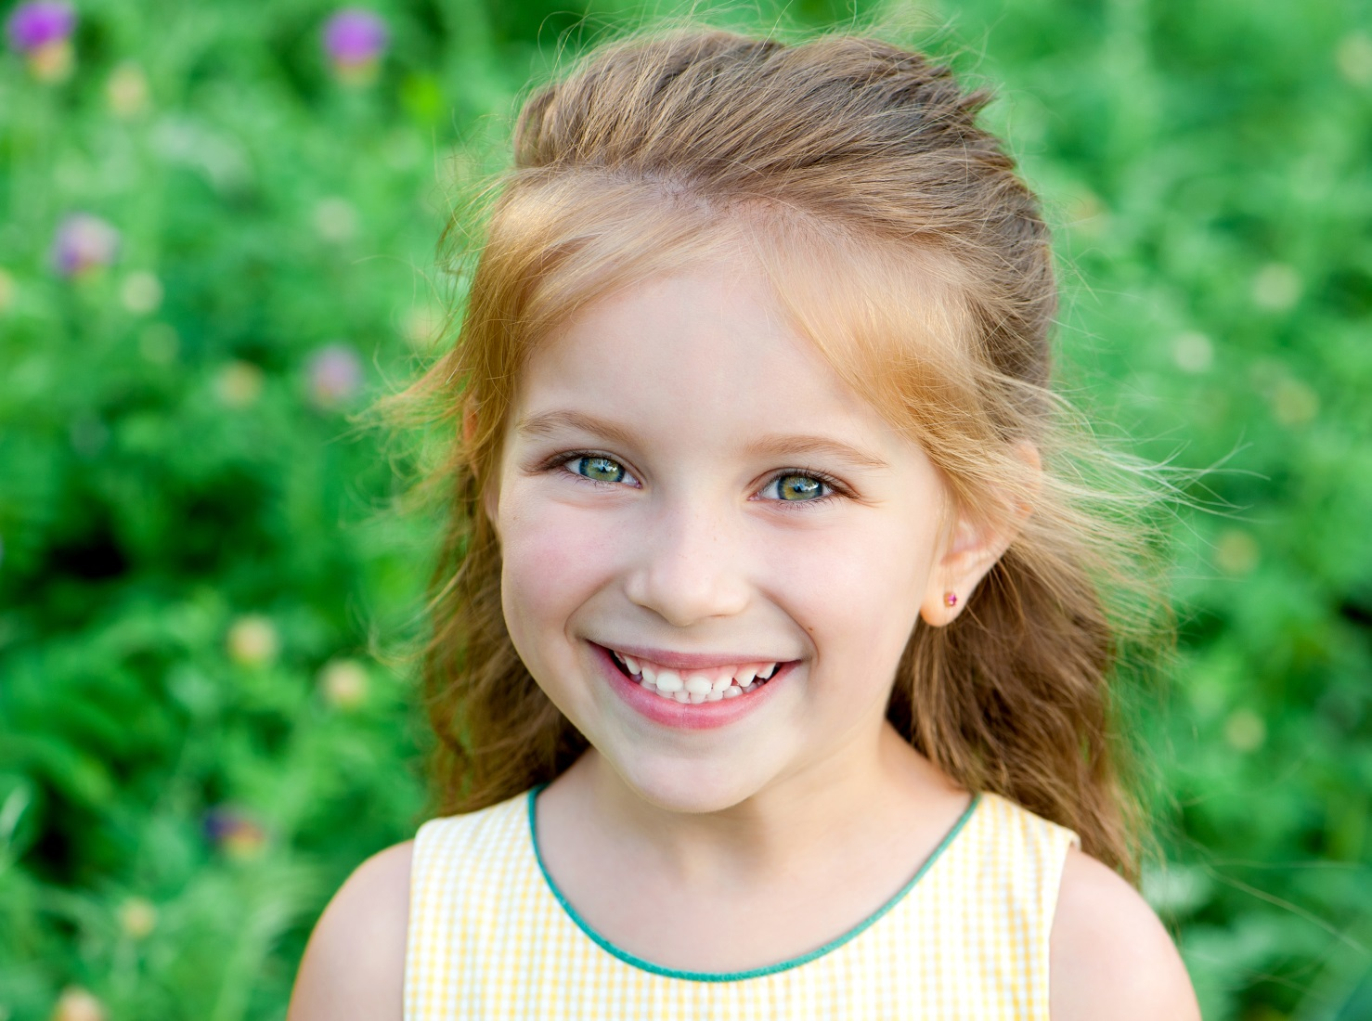
It feels good to be happy.
10

