Slide 1
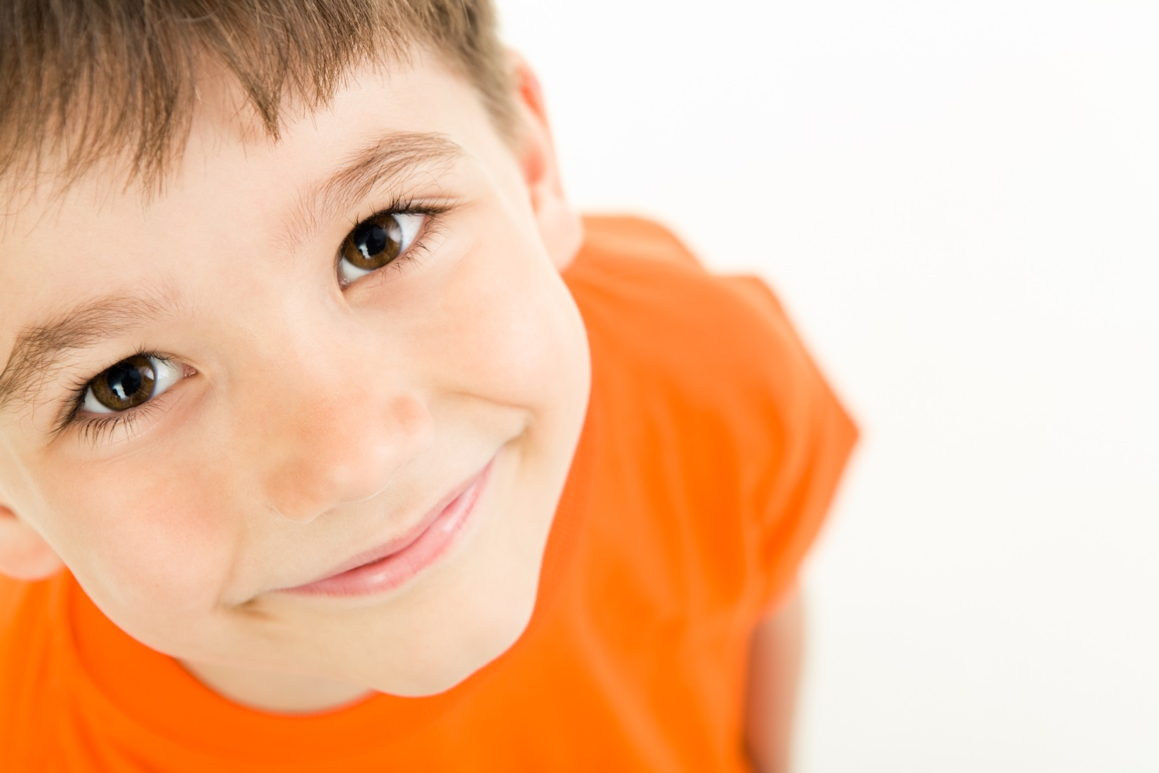
When I Feel Proud
The GRIT Program, 2017
Notes:
Scripted stories can also be used to help demonstrate anger. This is a sample of a story you might use.

Slide 2
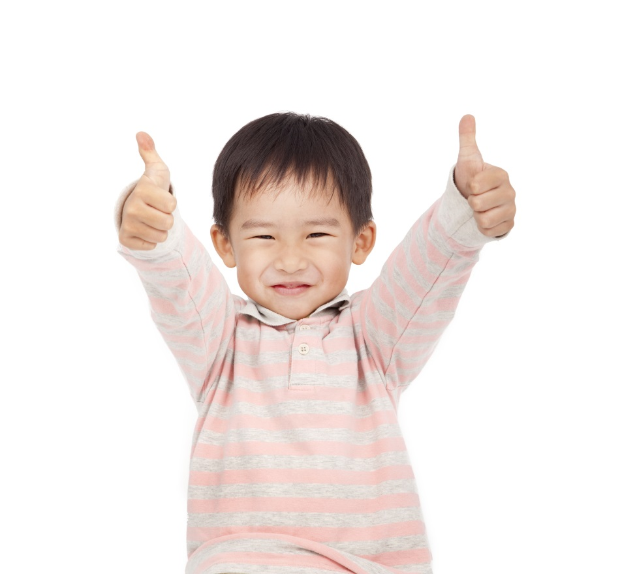
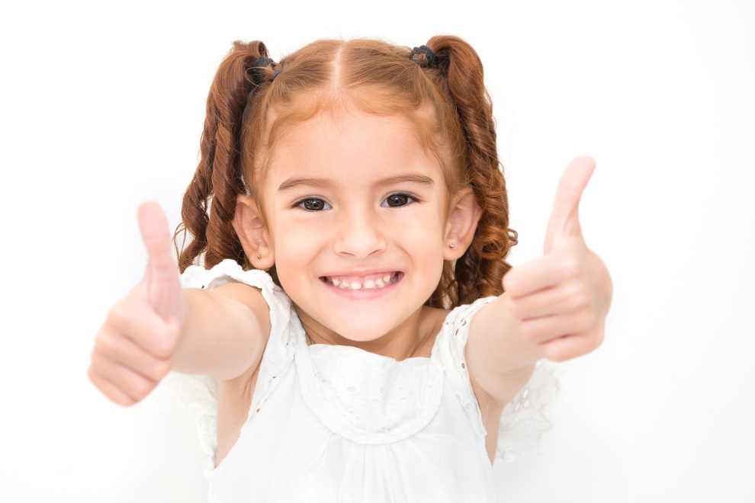
Sometimes, I feel proud.
I like it when I feel proud.
1

Slide 3
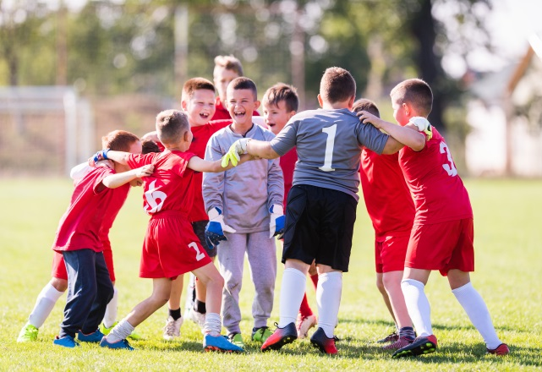
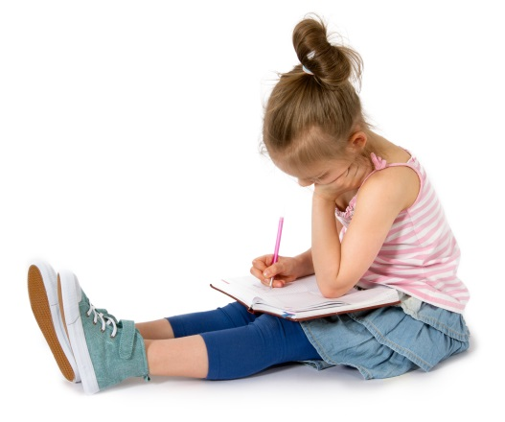
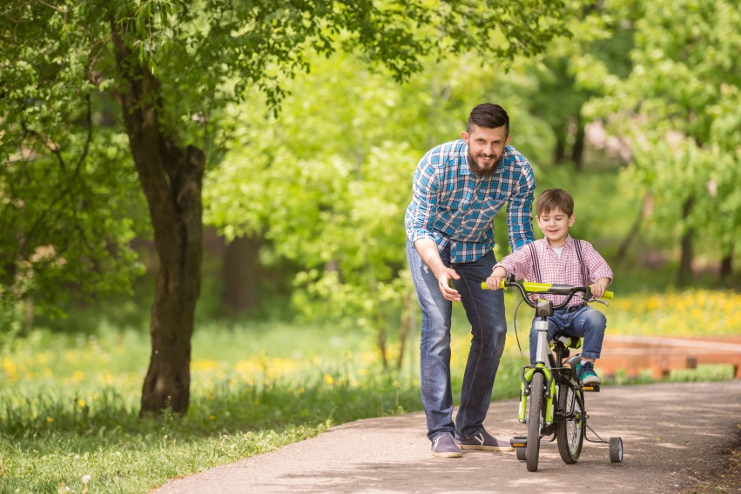
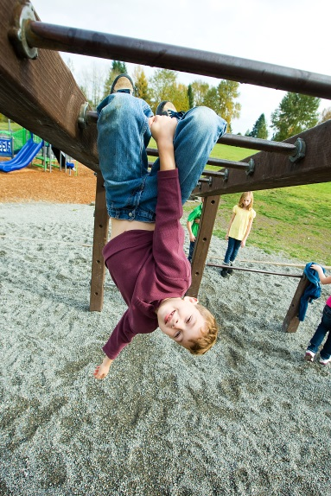
I might feel proud when…
I win a game.
I’m working hard on something.
I am learning to do something all by myself.
I try something new.
2

Slide 4
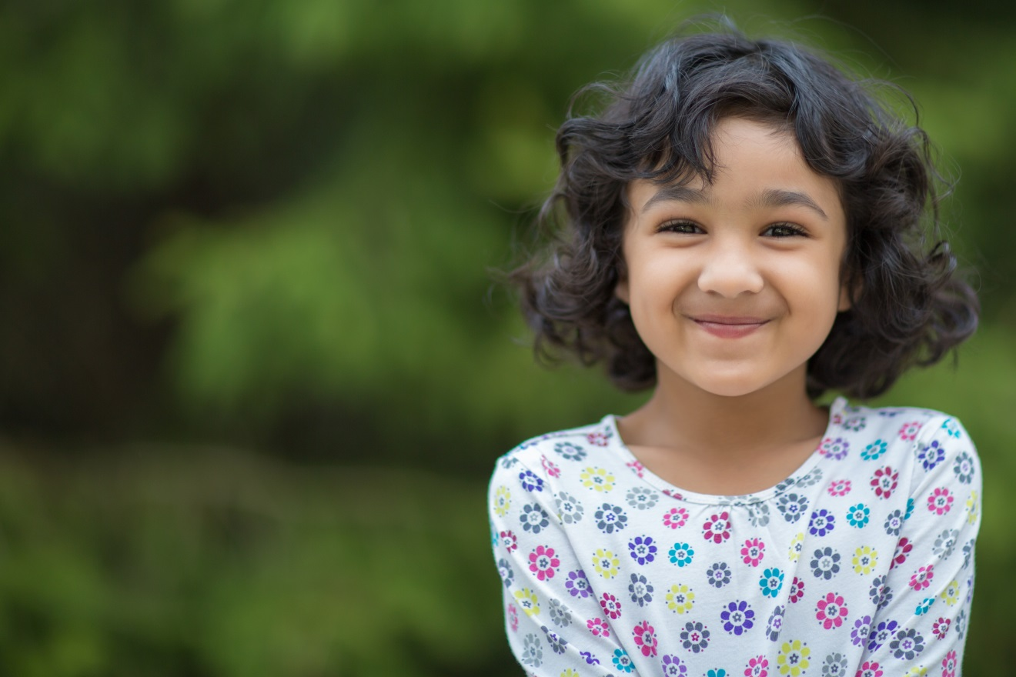
When I feel proud, it feels good!
I might smile when I feel proud.
3

Slide 5
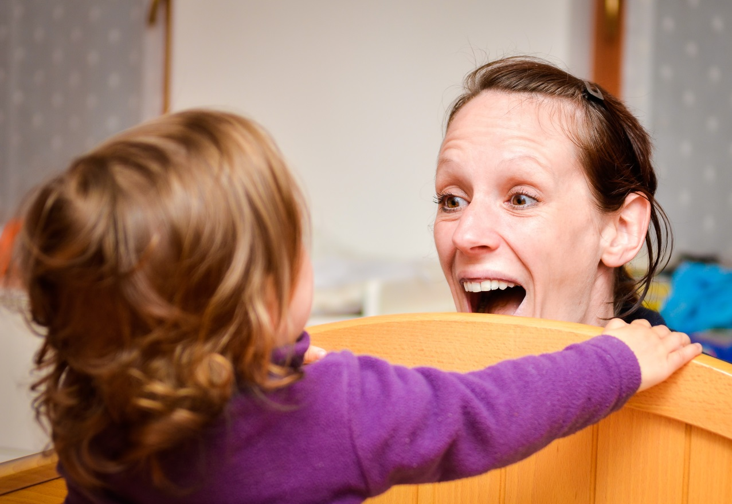
I can use my words to tell people: “I feel proud!”
When I feel proud, I can share my pride with others.
4
Notes:
This scripted story is a continuation of the story we read earlier – it is moving from recognizing anger to expressing it appropriately.

Slide 6
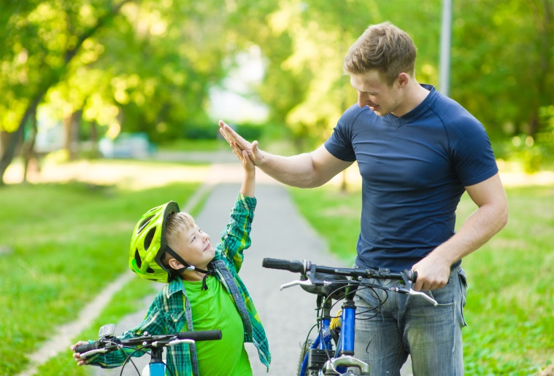
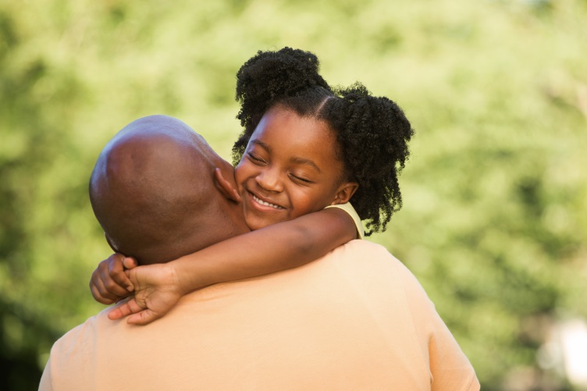
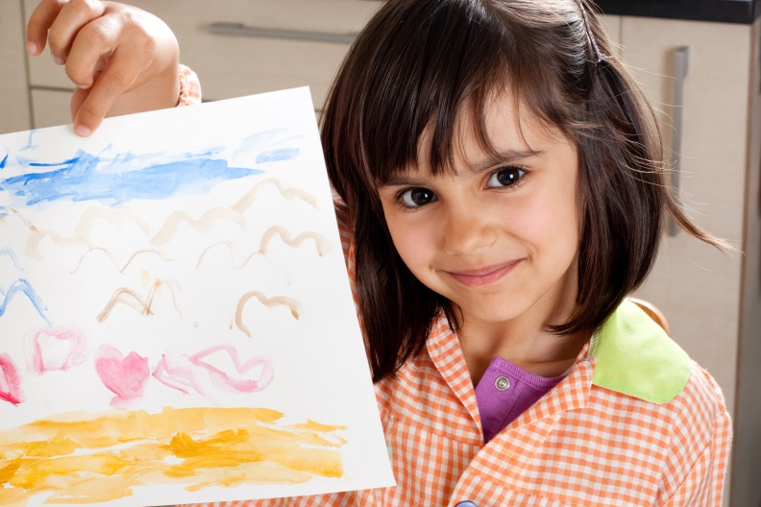
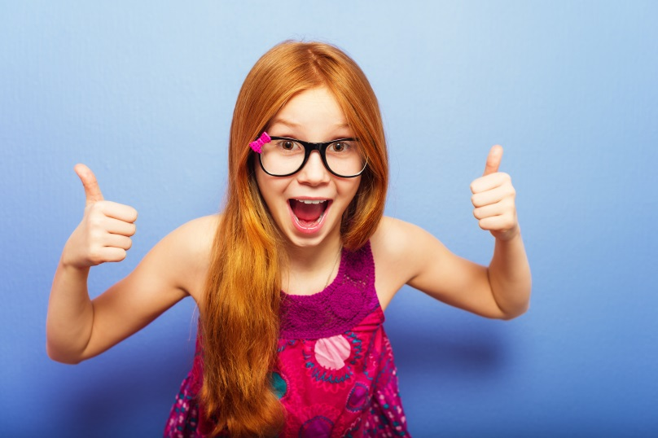
I can do other things when I feel proud.
I can give a high five.
I can hug someone.
I can show someone what I did.
I can give a little cheer.
5

Slide 7
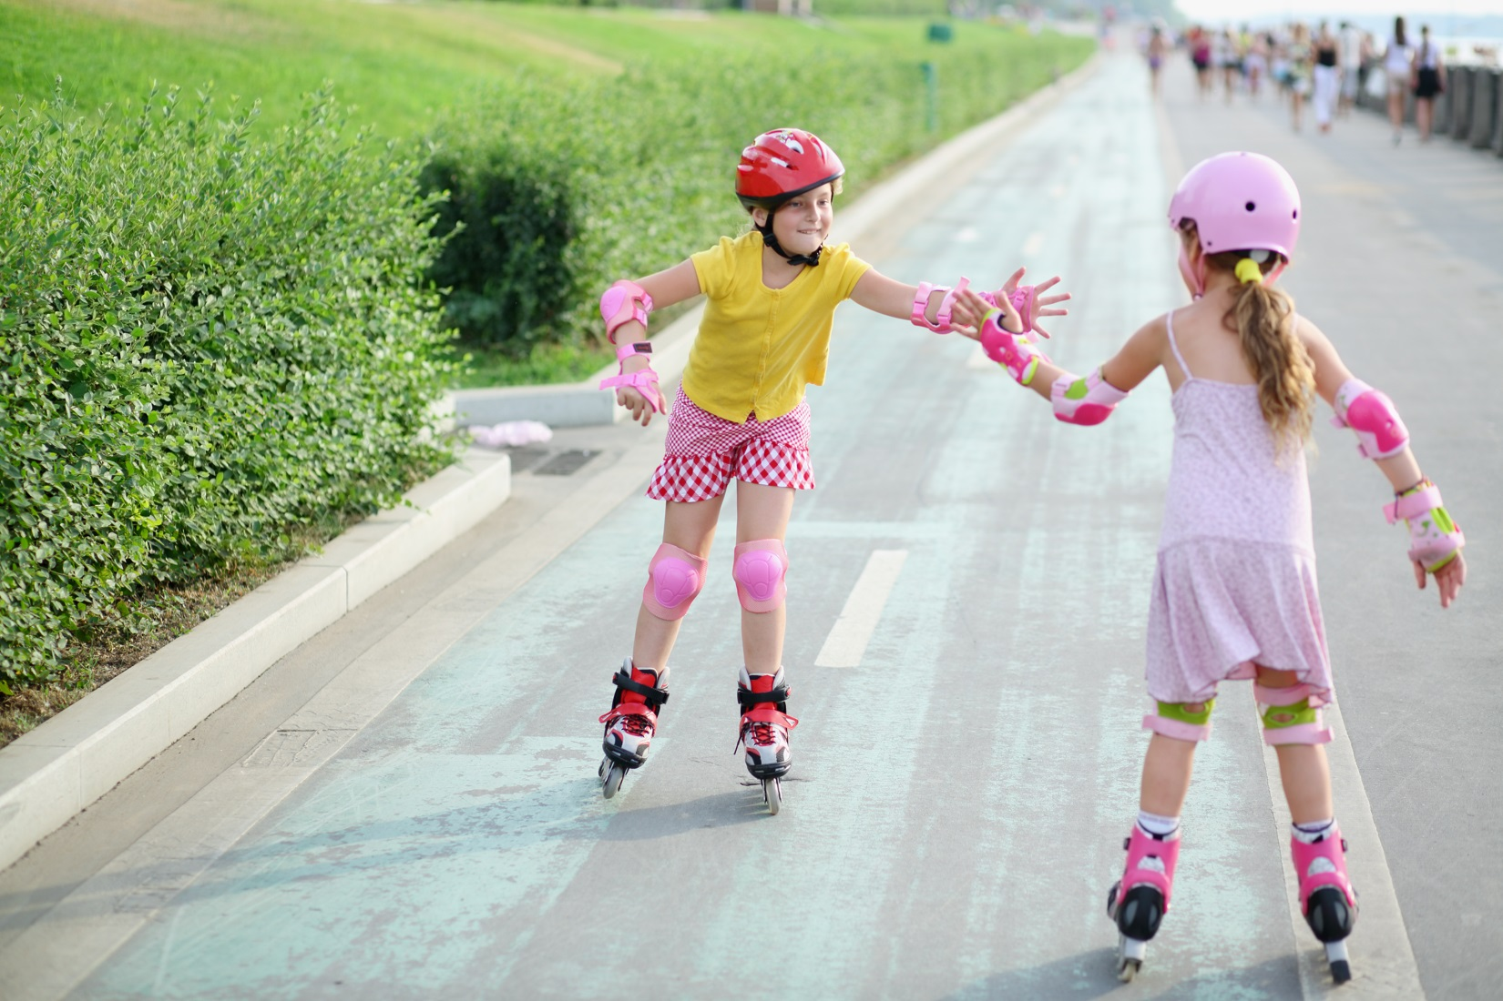
If I notice someone working hard, maybe I can help them feel proud!
6

Slide 8
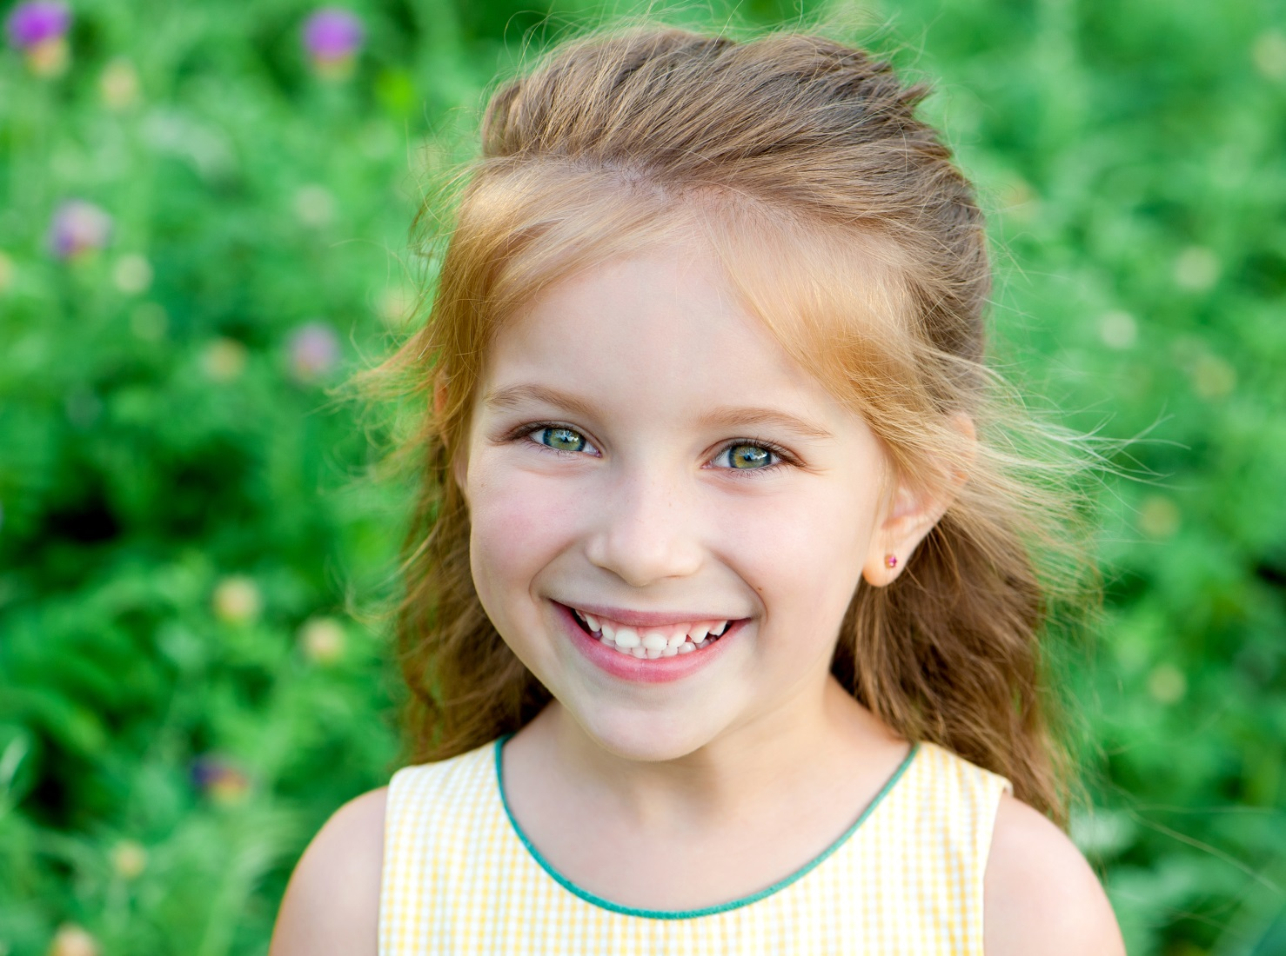
What will I feel proud of next?
7

