Slide 1
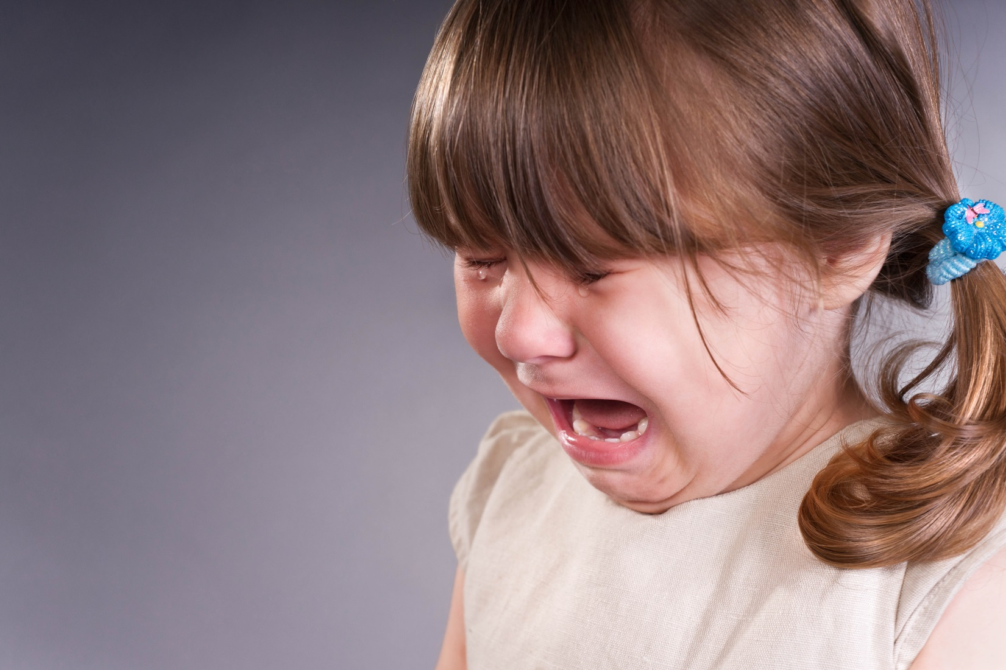
When I Feel Sad
The GRIT Program, 2015

Slide 2
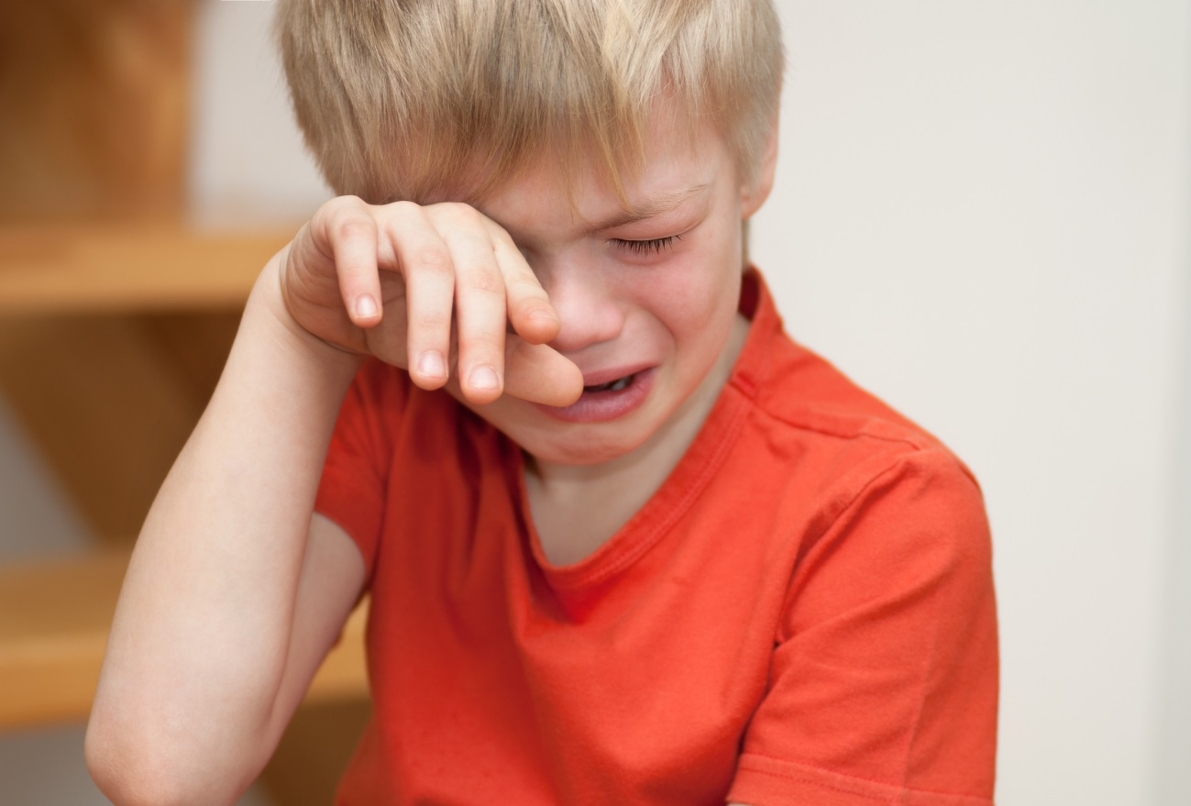
Sometimes, I feel sad.
It is okay to feel sad.
Everyone feels sad sometimes.
1

Slide 3
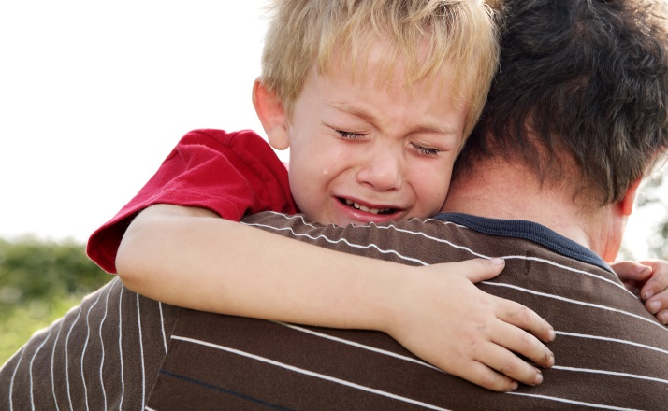
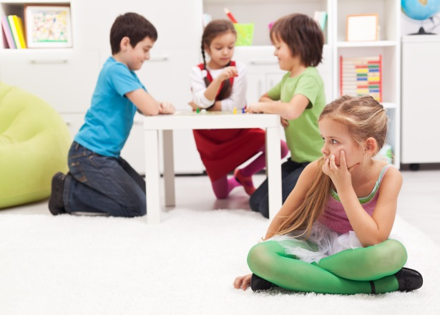
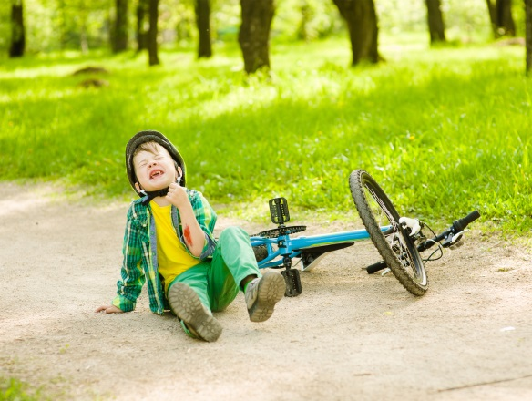
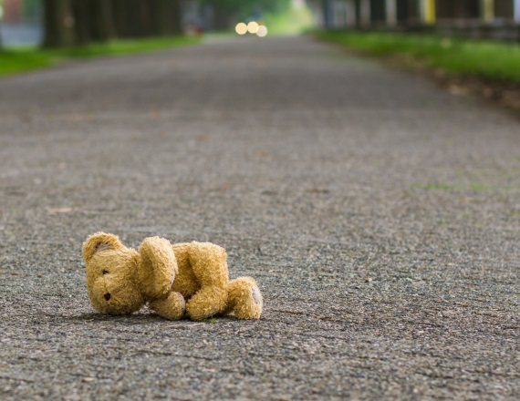
I might feel sad when…
My friends do not want
to play with me.
My mommy and daddy
go to work.
I lose my favourite toy.
I get hurt.
2

Slide 4
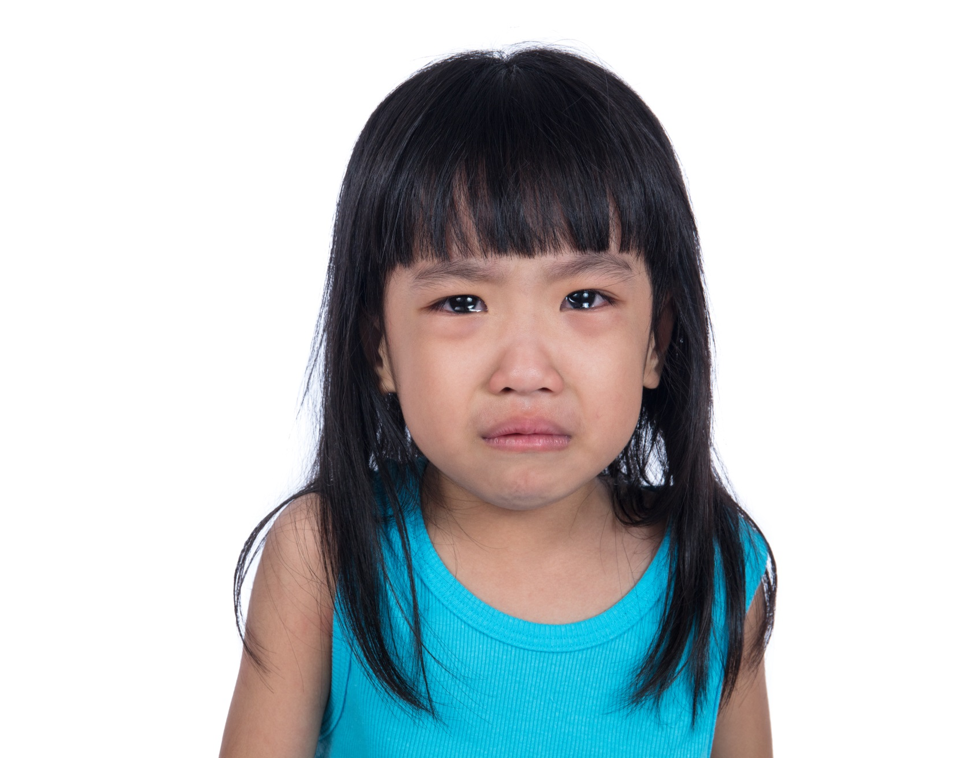
When I feel sad, I might want cry.
3

Slide 5
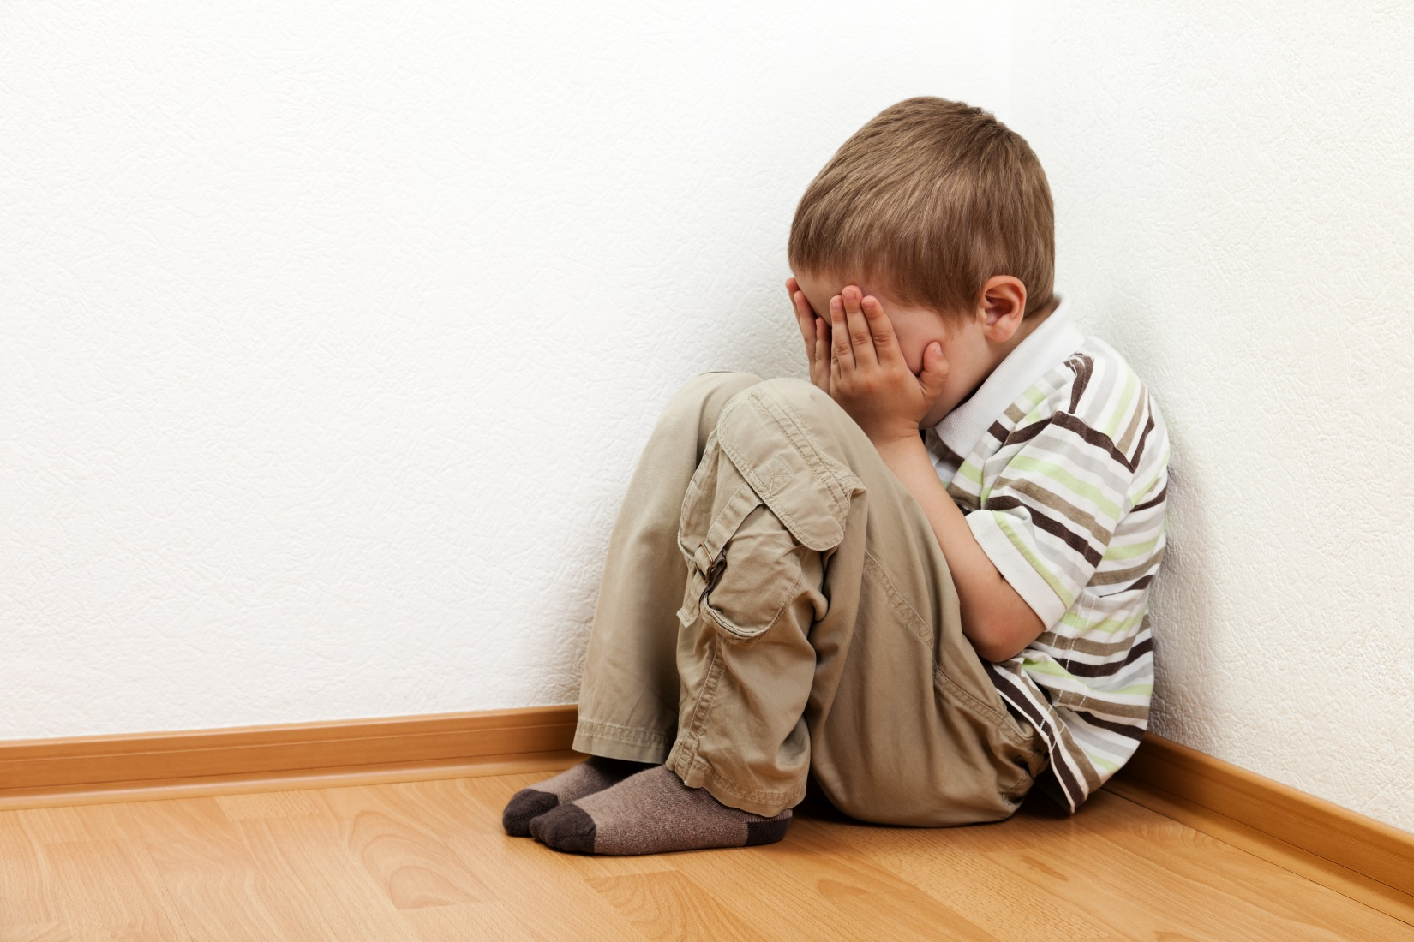
I might feel like hiding.
4

Slide 6
When I feel sad, I can help myself feel better.
My teachers and parents can help me feel better.
5
Notes:
Do you think this book should include some examples of HOW to feel better? Or appropriate ways to express anger?

Slide 7
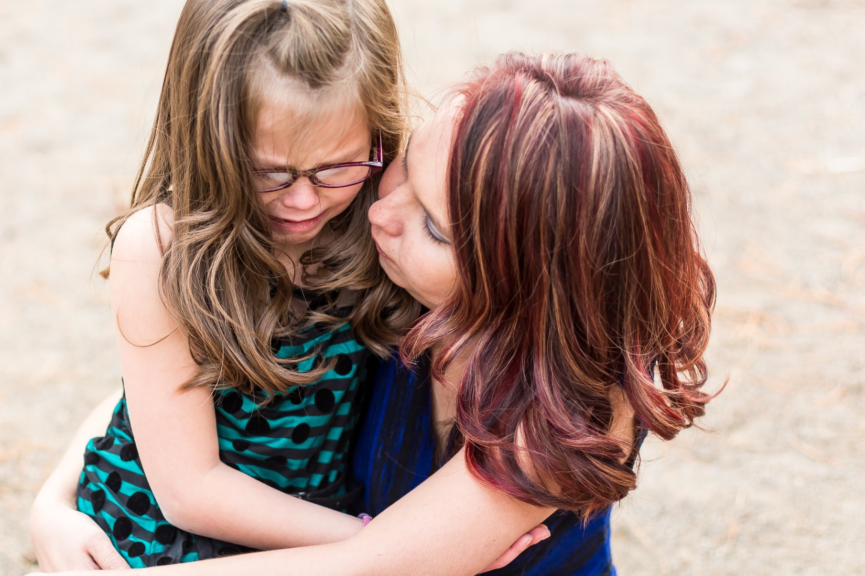
When I am feeling sad, I can use my words to tell people: “I feel sad.”
6
Notes:
This scripted story is a continuation of the story we read earlier – it is moving from recognizing anger to expressing it appropriately.

Slide 8
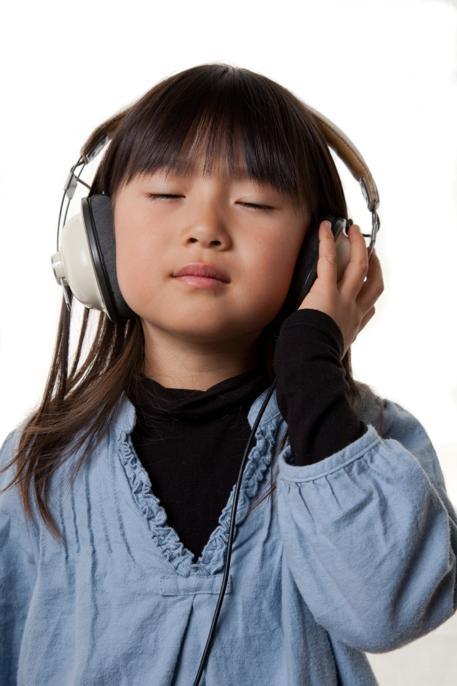
I can do other things to help me with my sadness.
I can go into a quiet space.
I can listen to music.
7

Slide 9
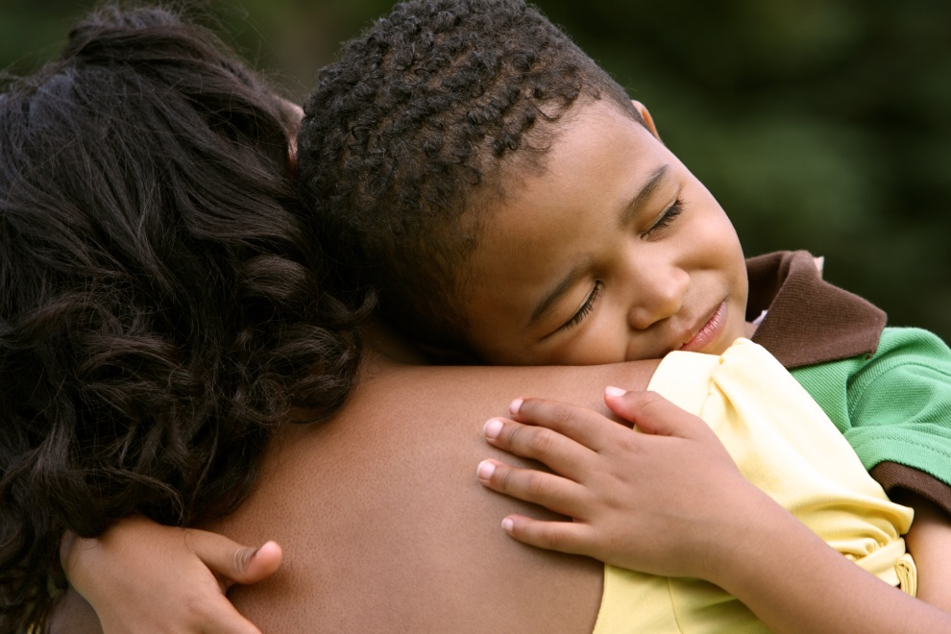
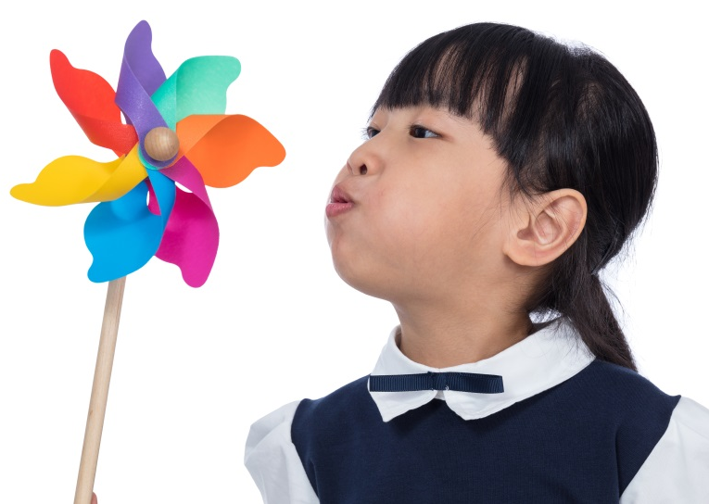
I can ask
for a hug.
I can take
deep breaths.
I can read a book.
8
Notes:
The “Sticker Picker” can be a great strategy for calming down.
If participants are not familiar with this strategy – describe it:
Laminate a piece of construction paper or card stock.
Put stickers on one side.
When children are upset, they can pick at the stickers on one side and move them to the other side.

Slide 10
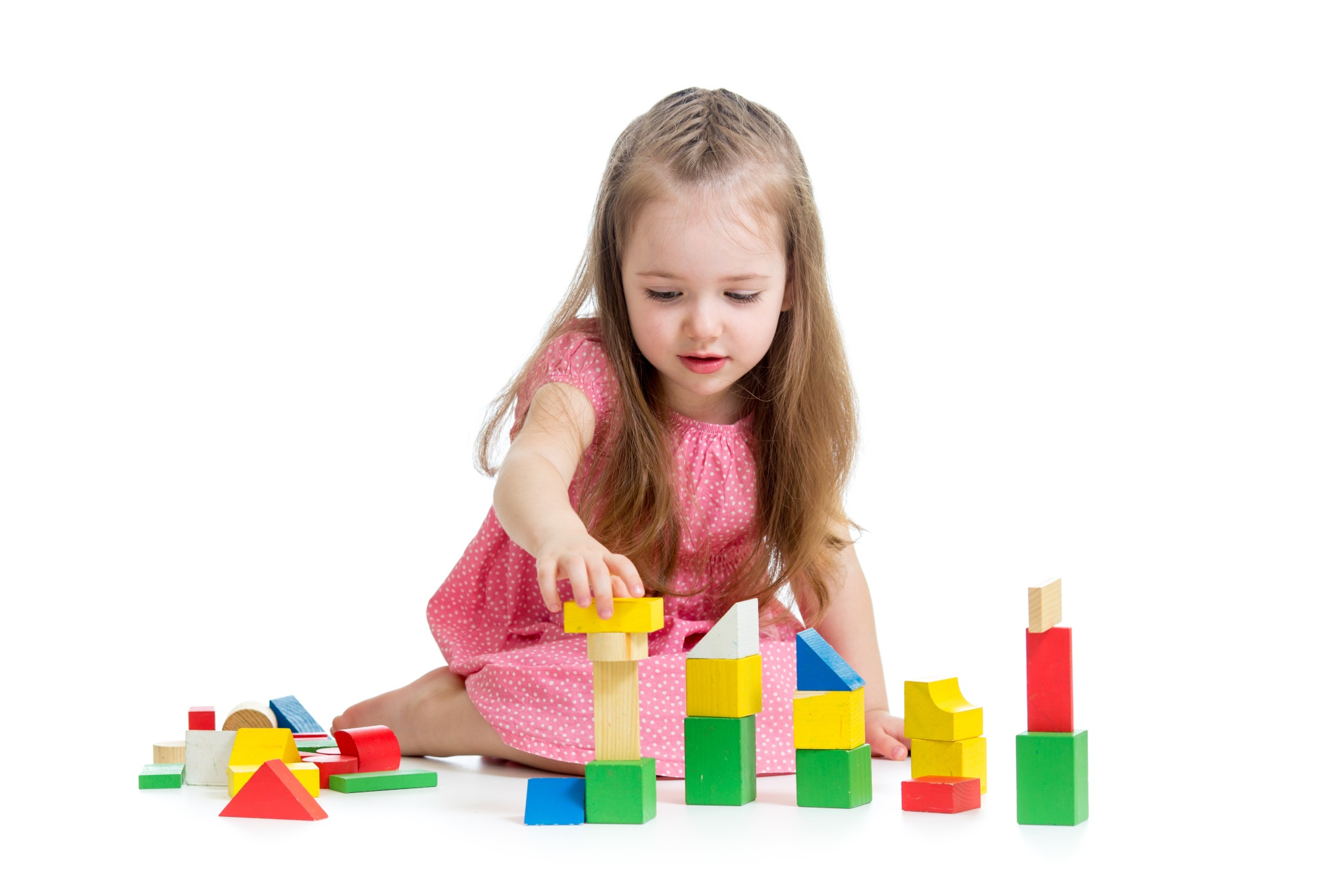
When I feel better, I can go back and play!
9

Slide 11
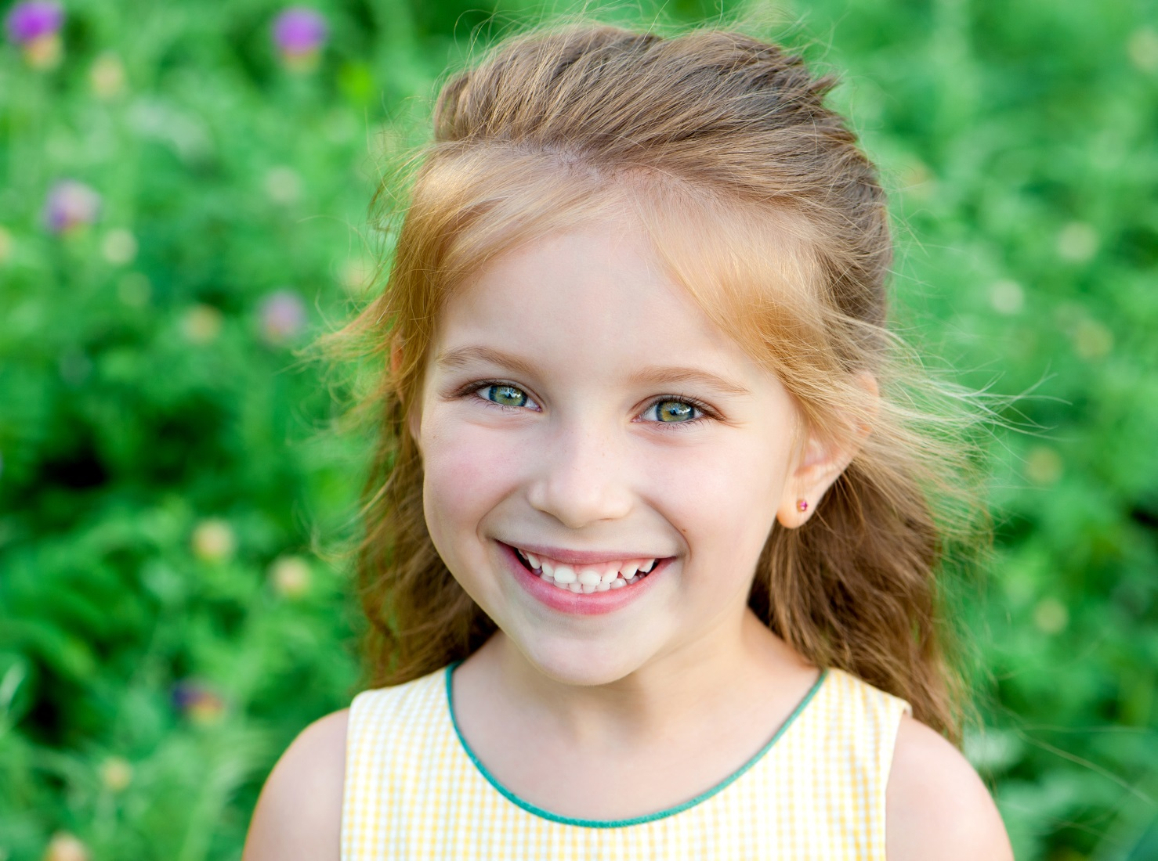
I will not feel sad forever.
10

