Slide 1
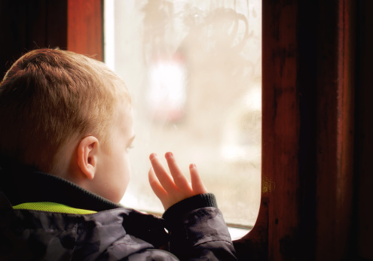
When I’m Waiting
The GRIT Program, 2015

Slide 2
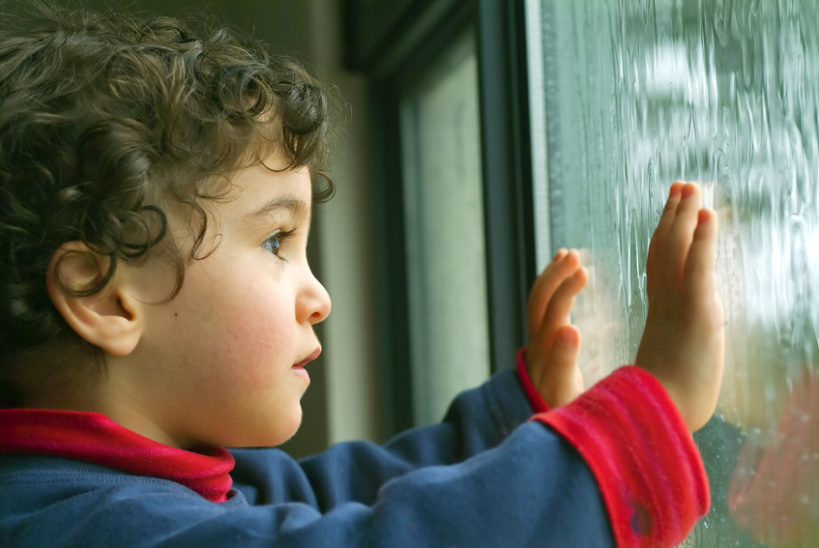
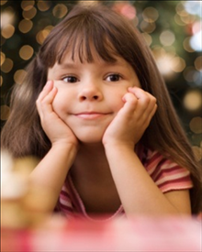
Sometimes, I find myself waiting for things.
It is an important job; I am learning how to do it.

Slide 3
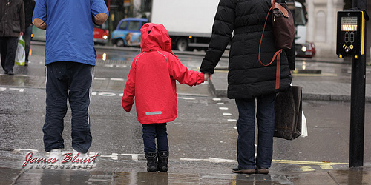
I wait at the crosswalk for the light to change; that helps me stay safe crossing the road.

Slide 4
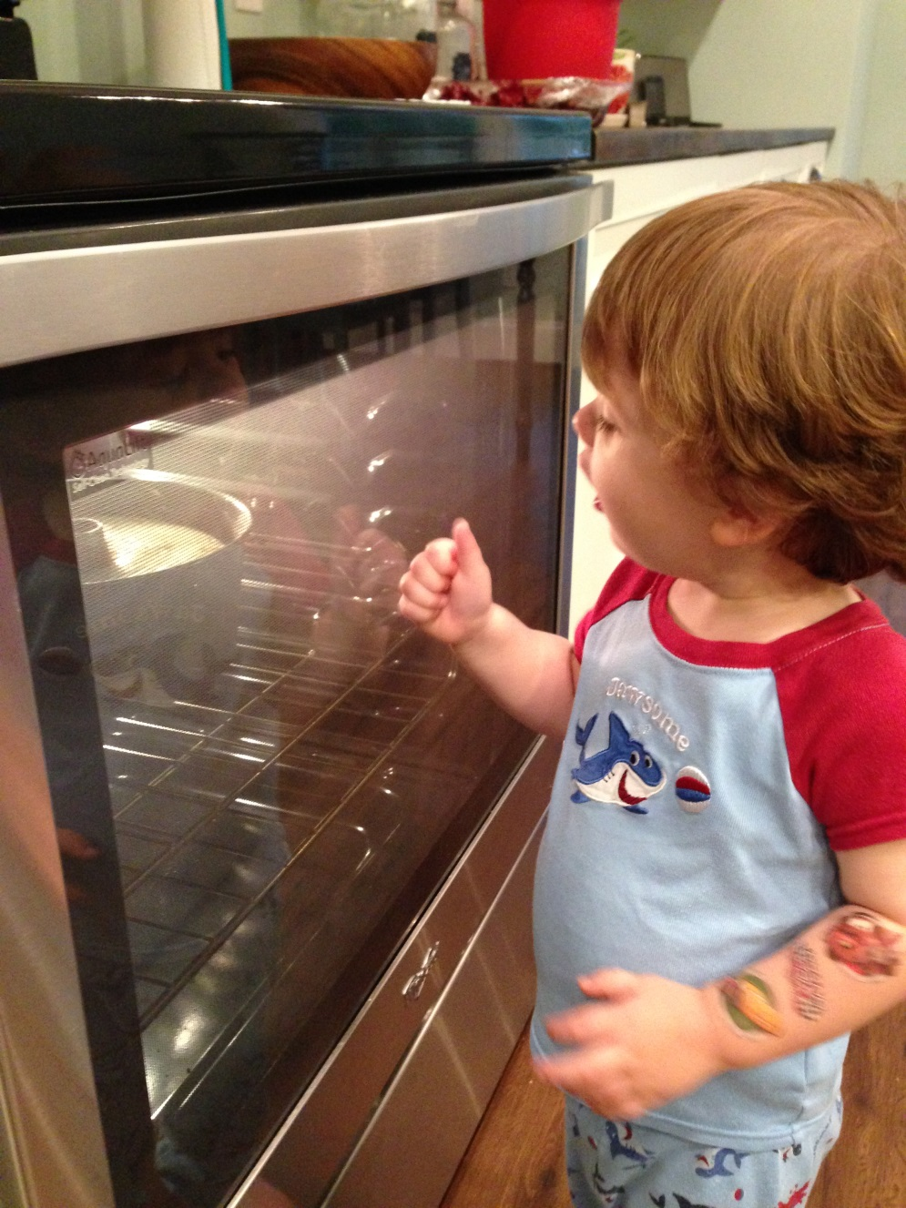
I wait for Mommy’s cake to bake; it doesn’t taste very good otherwise.

Slide 5
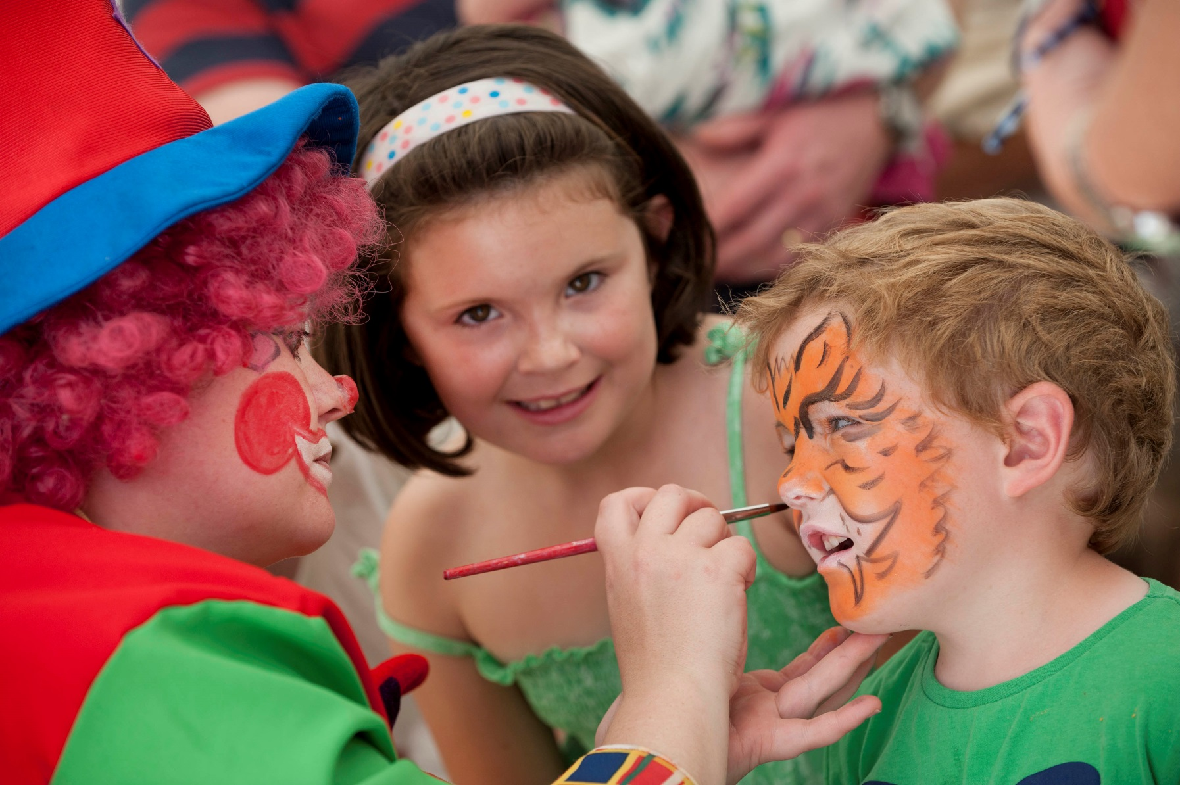
I wait when I get my face painted;
then the painter can finish her picture.

Slide 6
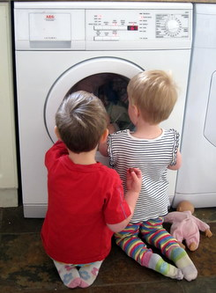
I wait for the washing machine to wash my stuffy;
then my stuffy will be all clean!

Slide 7
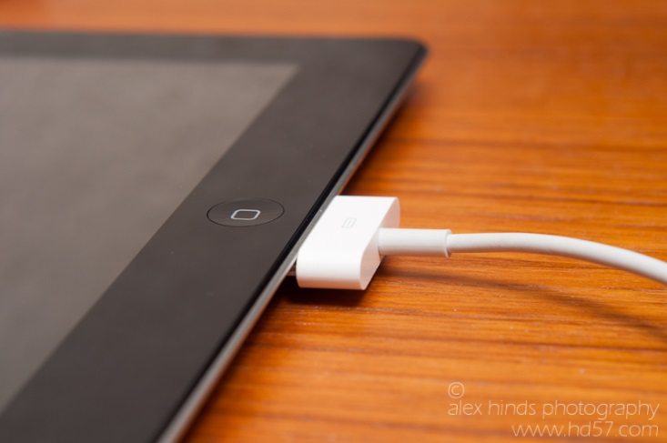
I wait for the iPad to charge;
I can’t use it if the battery doesn’t work.

Slide 8
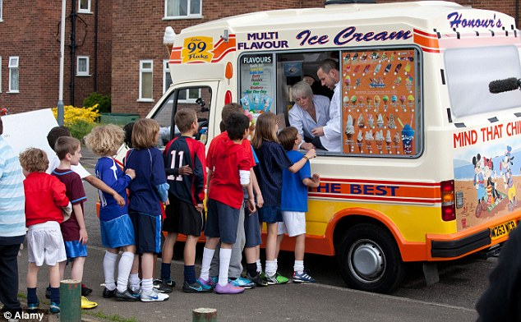
I wait in line for ice cream;
the ice cream server can’t scoop everyone’s cones at once.

Slide 9
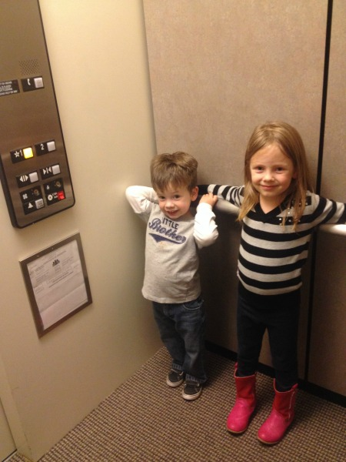
I wait in the elevator; it’s going all the way to the top of the building!

Slide 10
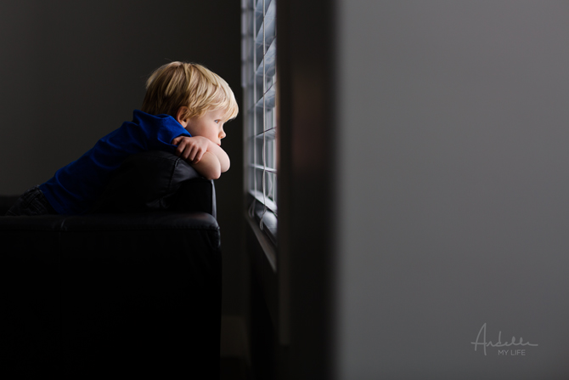
I wait for Dad to come back from the grocery store;
I know he’s buying my favourite snack!

Slide 11
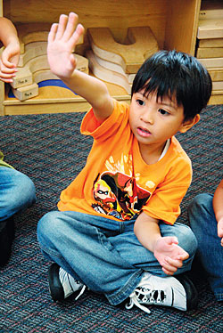
I wait for my turn to talk; my friend has something interesting to say.
I will get a turn to share my story too.

Slide 12
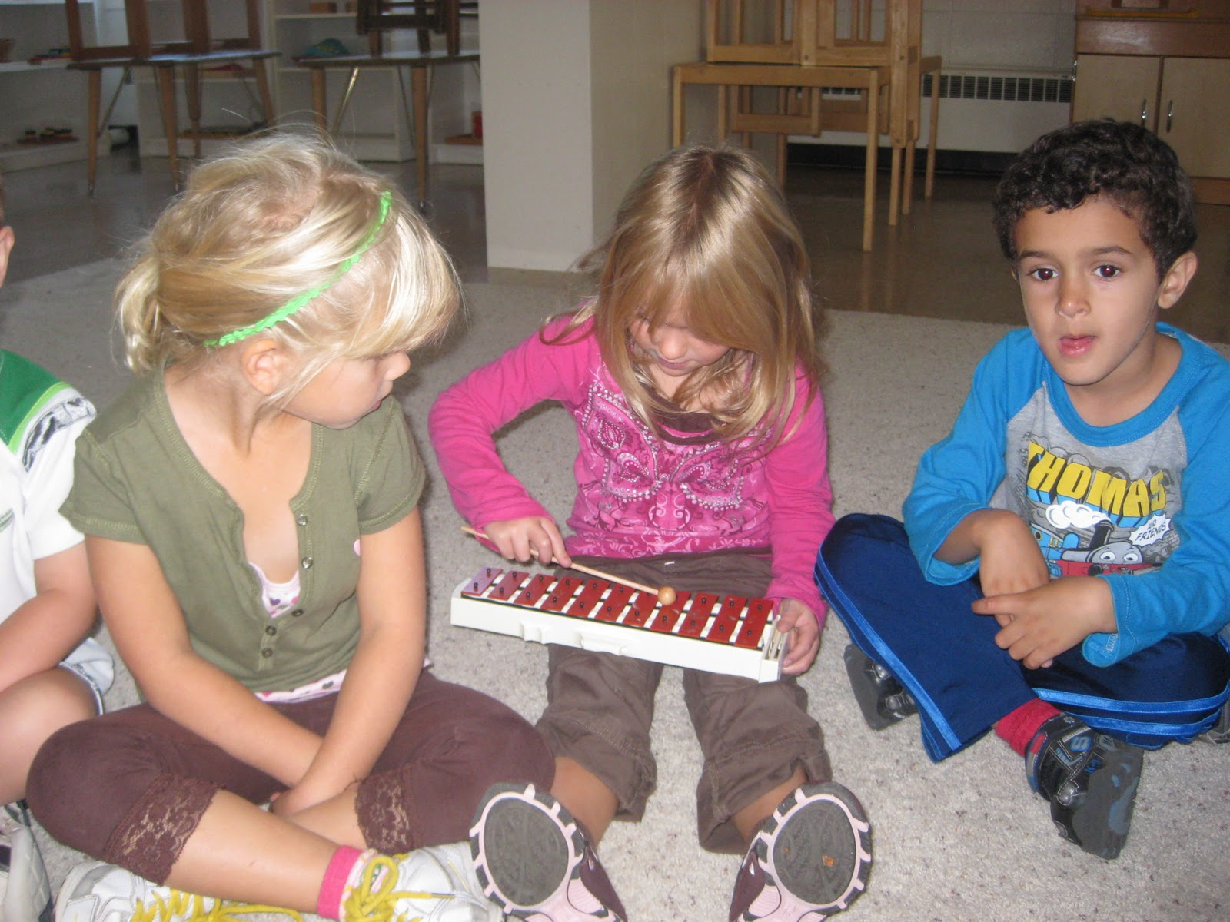
I wait for my turn with a toy; then my friend and I both have a chance to use it—that’s fair!

Slide 13
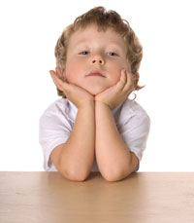
Sometimes it’s hard to wait for what I want. I might feel frustrated, bored, or impatient.

Slide 14
When I feel frustrated with waiting, there are things I can do:

Slide 15
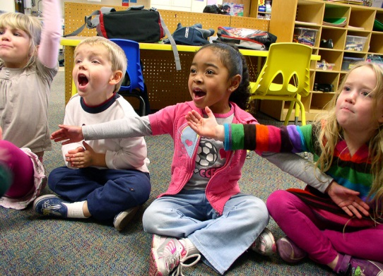
Sing a song to myself or with others.

Slide 16
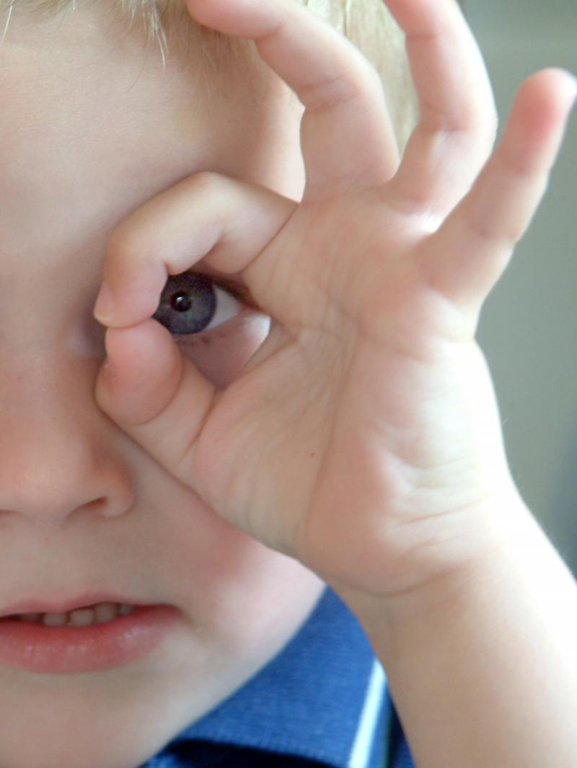
Play a game (like I Spy).

Slide 17
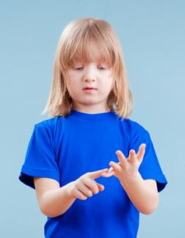
Count numbers—I wonder how high I could get?

Slide 18
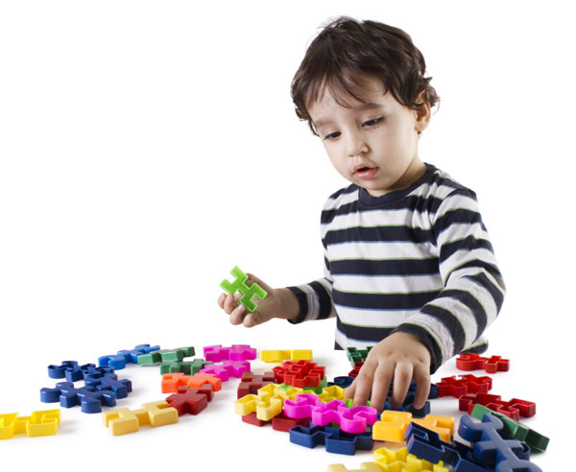
Go find something else to do.

Slide 19
Take a deep breath to stay calm.

Slide 20
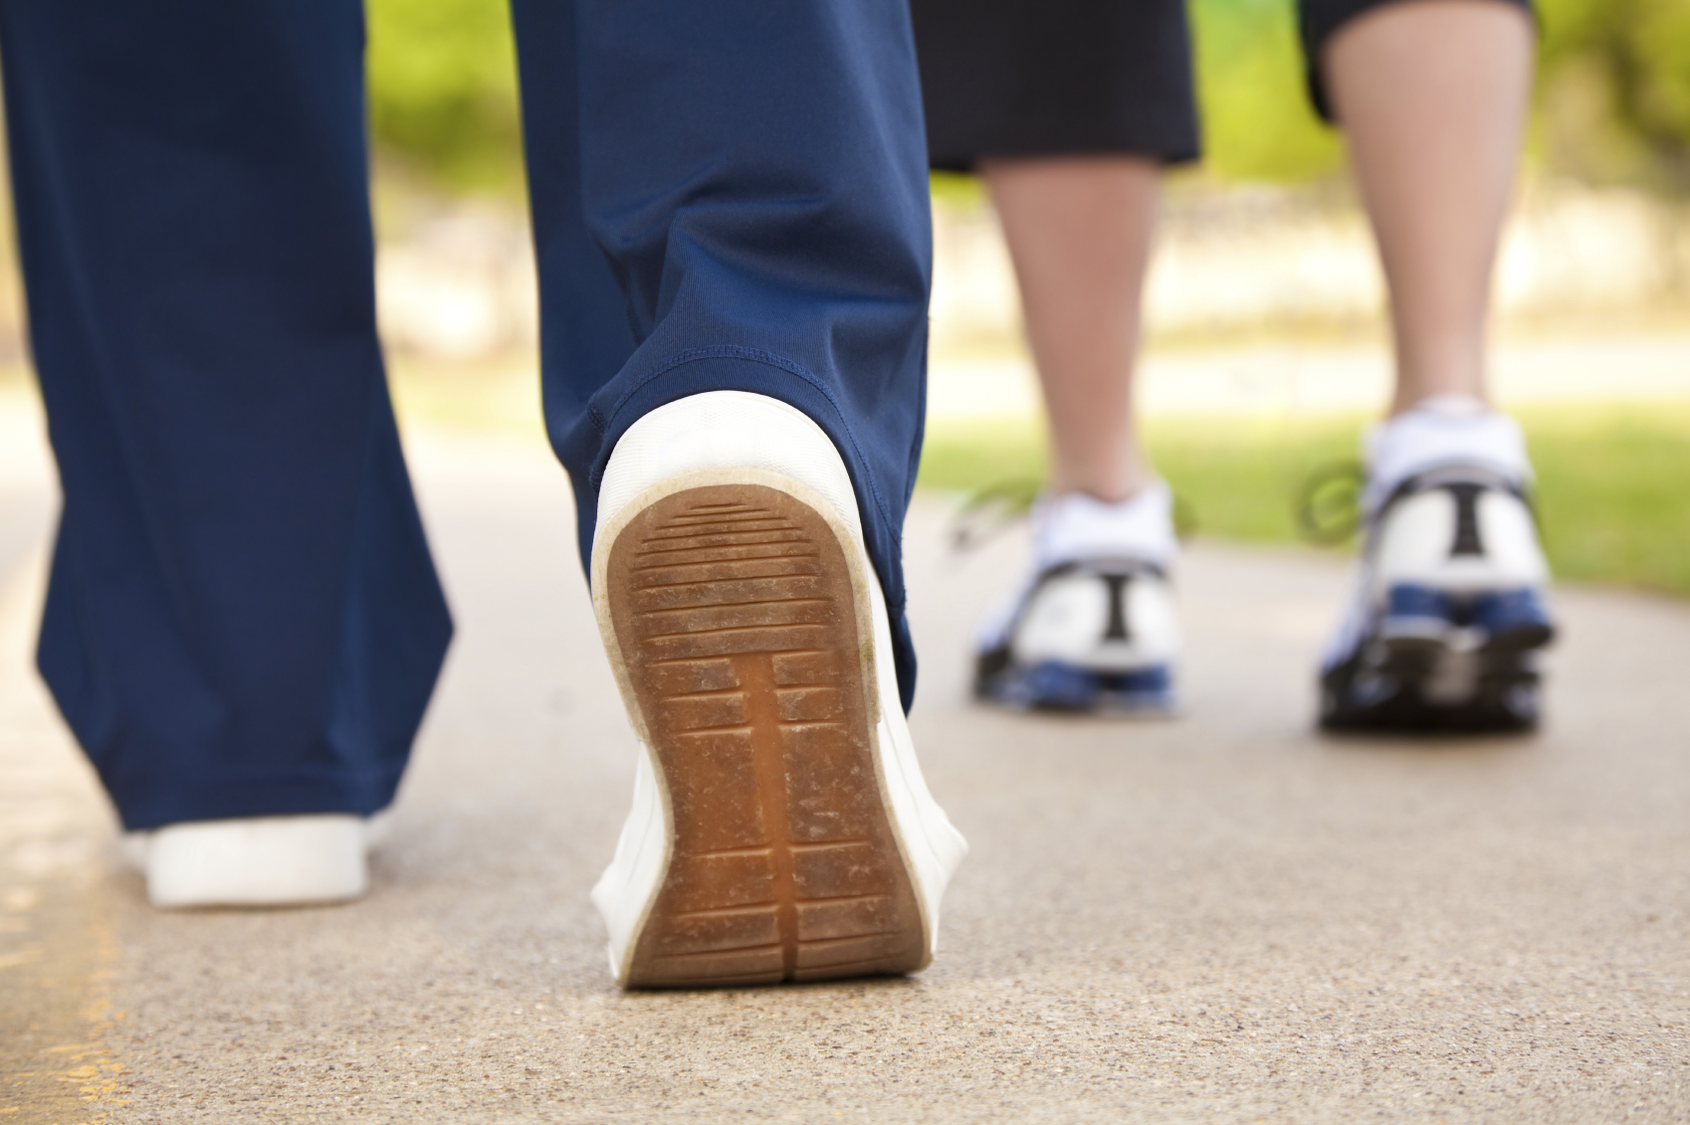
Take a walk.

Slide 21
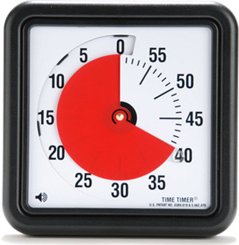
Set a timer so I know when to come back.

Slide 22
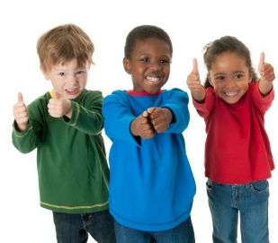
Waiting for special things is an important job;
I am learning how to do it!

